Slide 1
Practice Questions

Slide 2
Q1. Consider the transactions t1, t2 and t3 and a schedule S given below:
S: read₁(A); read₂ (B); write₁ (C); read₃(B); read₃ (C); write₂(B); write₃(A)
where subscript denotes the transaction number. Assume that the time stamp of t1<t2<t3. Using time-stamp ordering scheme for concurrency control find out if the schedule will go through. If there is to be a rollback, which transaction(s) will be rolled back?
t1 | t2 | t3
Read(A)
 | Read(B)
Write(C)
 |  | Read(B)
 |  | Read(C)
 | Write(B)
 |  | Write(A)

Slide 3
t1 | t2 | t3
Read(A)
 | Read(B)
Write(C)
 |  | Read(B)
 |  | Read(C)
 | Write(B)
 |  | Write(A)
Since this write in t2 is after a younger transaction (t3) has read the value of B, therefore t2 will be rolled back.

Slide 4
Q2. If transaction T1 reads a change made by transaction T2, then T1 commits only after T2 commits. This property of a transaction schedule is known as:
A) Strict
B) Serializable
C) Recoverable
D) Cascadeless
Ans: Recoverable
Schedules in which transactions commit only after all transactions whose changes they read commit are called recoverable schedules. In other words, if some transactions T2 is reading value updated or written by some other transaction T1 , then the commit of T1 must occur after the commit of T2.

Slide 5
Q3. In context of database, let T1 and T2 are two concurrent transactions. Consider the following sequence of operations on data X:
T1: R(X) T1:W(X) T2:R(X) T2:W(X)
This is a ____________________________ problem.
Dirty Read
Lost Update
Incorrect Summary
Unrepeatable Read
This is a Dirty Read problem.
T1 | T2
R(X)
W(X)
 | R(X)
 | W(X)

Slide 6
Q4. Let transaction T1 has obtained a shared mode lock S on data item Q and transaction T2 has obtained an exclusive mode lock X on data item R.
Consider the statement:
I. T1 can read Q but can’t write Q.
II. T2 can read R but can’t write R.
Which of the above statements is/are valid?
a. Only I
b. Only II
c. Both I and II
d. Neither I nor II
Option a:
Only I

Slide 7
Q5. Consider the following schedule and initial value of A =1000, B= 200. Find the resultant value of A and B if: f1(A) is A +10, f2(A) is A* 1.2 f3(B) is 20 + B and f4 (B) is B * 1.2.
Schedule | T1 | T2 | T3
Read(A) | Read(A)
A:=f1(A) | A:=f1(A)
Write(A) | Write(A)
Read(A) |  | Read(A)
A:=f2(A) |  | A:=f2(A)
Write(A) |  | Write(A)
Read(B) |  | Read(B)
B:=f3(B) |  | B:=f3(B)
Write(B) |  | Write(B)
Read(B) |  |  | Read(B)
B:=f4(B) |  |  | B:=f4(B)
Write(B) |  |  | Write(B)
A: 1212
B: 264

Slide 8
Q6. T1 consists of 5 operations and T2 consists of 4 operations, then the number of concurrent schedules possible is:
Ans. 126 ( n1+n2)!
(n1! * n2!)

Slide 9
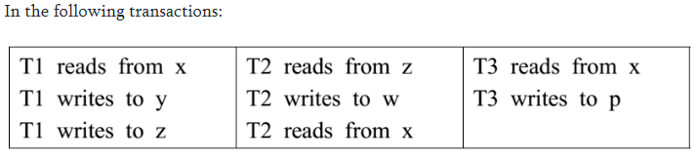
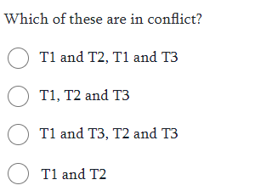
Q7.
a
d
b
c
d

Slide 10
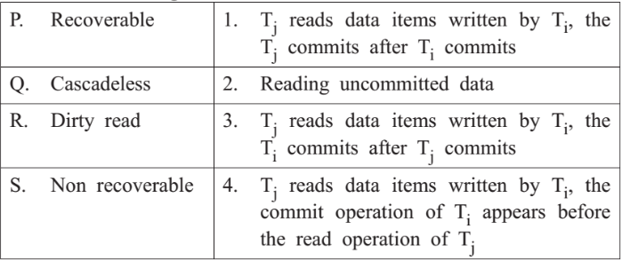
Q8.
P-1,Q-4,R-2,S-3

Slide 11
Q9. Consider the following five schedules where R depicts Read, W depicts Write, C depicts commit. State whether they are recoverable or non-recoverable.
(P) | (Q) | (R) | (S) | (T)
R1(A ) | R1(A) | R1(A) | R1(A) | R1(A)
W1(A) | W1(A) | W1(A) | W1(A) | W1(A)
R1(A) | W2(C) | R2(A) | R2(A) | C1
R2(B) | R2(C) | R2(B) | W2(A) | R2(A)
W2(B) | C2 | R1(B) | C2 | W2(A)
R2(A) | C1 | W1(B) | Abort C1 | C2
C2 |  | C1
C1 |  | C2
P=Irrecoverable as T2 is reading updated value before T1 commits.
Q= Recoverable as T2 is reading any updated value
R=Recoverable as T1 is commiting before T2
S= Irrecoverable because T2 operations are committing before T1 aborts.
T= Recoverable as T1 is commiting before T2

Slide 12
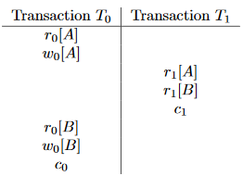
Q10. Consider the following two transactions and schedule (time goes from top to bottom).
I. Show how strict 2PL can ensure a conflict-serializable schedule for the same transactions above.
II. Show how the use of locks without strict 2PL can lead to a schedule that is NOT conflict serializable.

Slide 13
Transaction T0 | Transaction Ti
L0[A]
R0[A]
W0[A]
 | L1[A]→BLOCKS
L0[B]
R0[B]
W0[B]
U0[A]
U0[B]
C0
 | L1[A]→GRANTED
 | R1[A]
 | L1[B]
 | R1[B]
 | U1[A]
 | U1[B]
 | C1
I.

Slide 14
II.
Transaction T0 | Transaction Ti
L0[A]
R0[A]
W0[A]
U0[A]
 | L1[A]
 | R1[A]
 | U1[A]
 | L1[B]
 | R1[B]
 | U1[B]
 | C1
L0[B]
R0[B]
W0[B]
U0[B]
C0

Slide 15
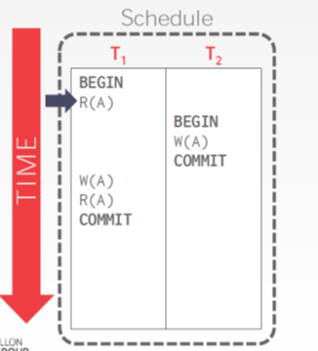
10
20
Object | R-TS | W-TS
A | 0 | 0
B | 0 | 0
Object | R-TS | W-TS
A | 10 | 20
B | 0 | 0
T1 will be rolled back
Identify which transaction will be rolled back?
Find the R-TS and W-TS for each data variable.

Slide 16
Q11. Assume basic timestamp ordering protocol and that time starts from 1, each operation takes unit amount of time and start of transaction Ti is denoted as Si. The table of timestamp is given below:
Time | Operation
1 | S1
2 | R1(A)
3 | S2
4 | R2(B)
5 | W2(B)
6 | W1(A)
7 | S3
8 | W3(A)
9 | W3(B)
Q. Find rts(a),wts(a),rts(b) and wts(b) at the end
a. 1, 5, 2, 5
b. 1, 7, 3, 3
c. 3, 7, 3, 7
d. 1, 7, 3, 7
Option d

Slide 17
T1 starts at TS =1
T2 starts at TS = 3
T3 starts at TS =7.
While giving the TS for any read or write always look for youngest.
RTS(a) = a is first read by T1 hence RTS(a) =1. (Read(a) is never done anywhere again hence it is youngest)
WTS(a) = a is first written by T2 hence WTS(a) = 3. But again written by T3 which has higher TS (youngest) Hence final TS of W(a) = 7
RTS(b) = b is first read by T2 hence RTS(b) =3. (Read(b) is never done anywhere again hence it is youngest)
WTS(b) = b is first written by T2 hence WTS(b) = 3. But again written by T3 which has higher TS (youngest) Hence final TS of W(b) = 7
Hence answer is 1,7,3,7

Slide 18
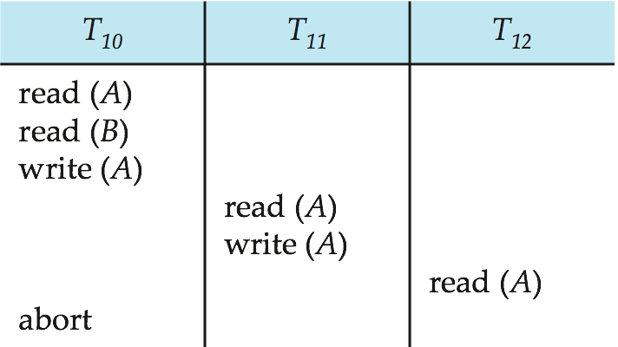
Q. 12 Identify the type of schedules
A.
Cascading rollback – a single transaction failure leads to a series of transaction rollbacks. Consider the following schedule where none of the transactions has yet committed

Slide 19
Q13. Find the R-TS and W-TS for the following schedules:
T1(TS-100) | T2(TS-200) | T3(TS-300)
R(A)
 | R(B)
W(C)
 |  | R(B)
R(C)
 | W(B)
 |  | W(A)
T2 will be rolled back.
Identify which transaction will be rolled back?
Find the R-TS and W-TS for each data variable.
 | A | B | C
R-TS | 100 | 300 | 100
W-TS | 300 | 0 | 100

Slide 20
Q14. Consider a relation- R ( V , W , X , Y , Z ) with functional
dependencies-
VW → XY
Y → V
WX → YZ
Find the highest normal form?
Ans: CK: VW , WX , WY
Prime attributes = { V , W , X , Y }
Non-prime attributes = { Z }
There is no partial dependency.
This is because there exists no dependency where incomplete candidate key determines any non-prime attribute.
Thus, we conclude that the given relation is in 2NF.

Slide 21
Q15 Which normal form is considered adequate for normal relational database design?
2NF (b) 5NF (c) 4NF (d) 3NF
Ans: option (d)
Explanation: A relational database table is often described as "normalized" if it is in the Third Normal Form because most of the 3NF tables are free of insertion, update, and deletion anomalies.

Slide 22
Q16 Consider a schema R(A, B, C, D) and functional dependencies A -> B and C -> D. Then the decomposition of R into R1 (A, B) and R2(C, D) is
(a) dependency preserving and lossless join
(b) lossless join but not dependency preserving
(c) dependency preserving but not lossless join
(d) not dependency preserving and not lossless join
Ans: option (c)
Explanation:
While decomposing a relational table we must verify the following properties:
i) Dependency Preserving Property: A decomposition is said to be dependency preserving if F⁺=(F1 ∪ F2 ∪ .. Fn)⁺, Where F⁺=total functional dependencies(FDs) on universal relation R, F1 = set of FDs of R1, and F2 = set of FDs of R2. For the above question R1 preserves A->B and R2 preserves C->D. Since the FDs of universal relation R is preserved by R1 and R2, the decomposition is dependency preserving. ii) Lossless-Join Property: The decomposition is a lossless-join decomposition of R if at least one of the following functional dependencies are in F+:- a) R1 ∩ R2 -> R1 b) R1 ∩ R2 -> R2 It ensures that the attributes involved in the natural join ( ) are a candidate key for at least one of the two relations.In the above question schema R is decomposed into R1 (A, B) and R2(C, D), and R1 ∩ R2 is empty. So, the decomposition is not lossless.

Slide 23
Q17 A table has fields F1, F2, F3, F4, and F5, with the following functional dependencies: F1->F3 F2->F4 (F1,F2)->F5 in terms of normalization, this table is in (a) 1NF (b) 2NF (c) 3NF (d) None of these
Ans: option (a)
Explanation: Since the primary key is not given we have to derive the primary key of the table. Using the closure set of attributes we get the primary key as (F1,F2). From functional dependencies, "F1->F3, F2->F4", we can see that there is partial functional dependency therefore it is not in 2NF. Hence the table is in 1NF.

Slide 24


